Slide 1
CPS 109 - Lab 1

Slide 2
Agenda
0 - Housekeeping
1 - Terminology
2 - Setting Up Python
3 - IDEs/Text Editors To Use
4 - Data Types
5 - Keywords
6 - Syntax
7 - Examples

Slide 3
Housekeeping
There are a few things that you should know:
1 - These slides won’t be posted to D2L. Instead, they’re on Cassandra’s GitHub.
2 - Said GitHub also has examples! You don’t need to know how to use GitHub to look at them. Just follow this link and go into the folders you want to see:
https://github.com/cassLaffan/CPS109

Slide 4
Logging Into TMU Machines
Wiggle your mouse. If you screen doesn’t wake up, press the power button and select the Windows boot once prompted.

Slide 5
Logging Into TMU Machines
Your username for labs can be found at my.ryerson.ca! To find it, follow these steps:
Click the drop down list at the top right of the page, with the little blue icon of a man.
Click the first option, "Personal Account".
Click the first option, "Personal Information".
Your username for the lab computers is the my.ryerson Short ID.

Slide 6
Logging Into TMU Machines
Your default password has the format of: MMDDXXXX
MM = your birth month, so mine is 10.
DD = your birth date, so mine is 27.
Finally, the XXXX are the last four digits of your student number.

Slide 7
Some Quick Terminology
Program - A set of instructions that a computer can interpret and execute
Programming/Coding - The act of writing a program
Python - The programming language we will be using for this course

Slide 8
Setting Up Python
Python is already installed on these computers. However, I encourage you to install it on your personal computer as well.

Slide 9
Setting Up Python
Go to Python.Org and click the big download button.
If you run Linux (and somehow don’t have Python installed), you can also install it through your terminal.

Slide 10
IDEs? Text Editors?
Now you’ll need some way to write Python code now that you’ve installed it. You have two choices: an IDE or a text editor.

Slide 11
Integrated Development Environments (IDEs)
This is where you can type code and the computer will tell you if you have typos or errors and even run the program for you.
IDLE is the default for most Python beginners and can be found at Python.org
The lab computers have Spyder already installed.

Slide 12
Text Editors
You type your code into a text editor and then run it elsewhere (typically your terminal/CMD)
This option is more for students who want to learn programming while familiarizing themselves with navigating the terminal/CMD.
I suggest VSCode or Atom (both free), because they still underline typos or errors without being intrusive like an IDE.

Slide 13
Data Types
Integer: A whole number (e.x. 2 or -5)
Float: A “decimal” number (e.x. 4.3 or 2.22222…)
Boolean: A value of either True or False

Slide 14
Data Types
Character: A single letter or symbol (e.x. ‘a’ or ‘b’)
String: A “string” of any numbers or characters as denoted by quotes (‘’ or “”)

Slide 15
Keywords
These are reserved by Python so it can follow your instructions. For example:
“and”, “or”, “not” and “return”
To see a list of all keywords, type help() into your python prompt and then “keywords”

Slide 16
Python Syntax
We have several instances of syntax examples posted on the GitHub. We encourage you to use them as references when doing your labs!
If we went over each individual syntax example one at a time, you wouldn’t have time to do your labs! So here are a few examples.

Slide 17
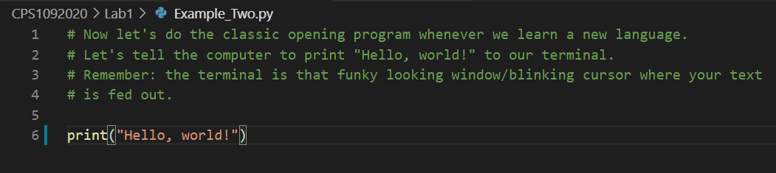
“Hello World” Example

Slide 18
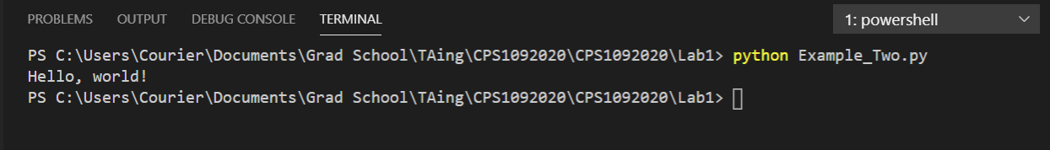
“Hello World” Output

Slide 19
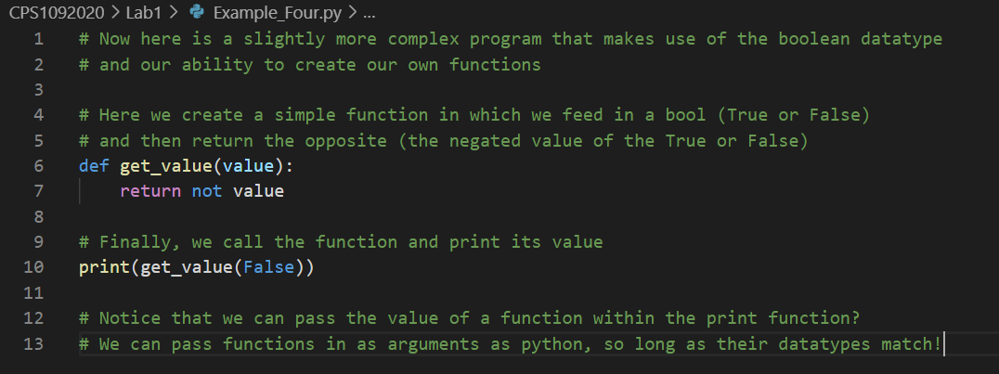
Def Function Example

Slide 20
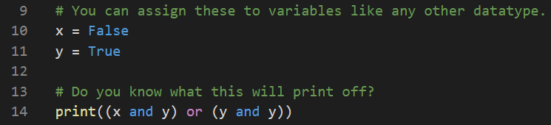
Logic Example

Slide 21
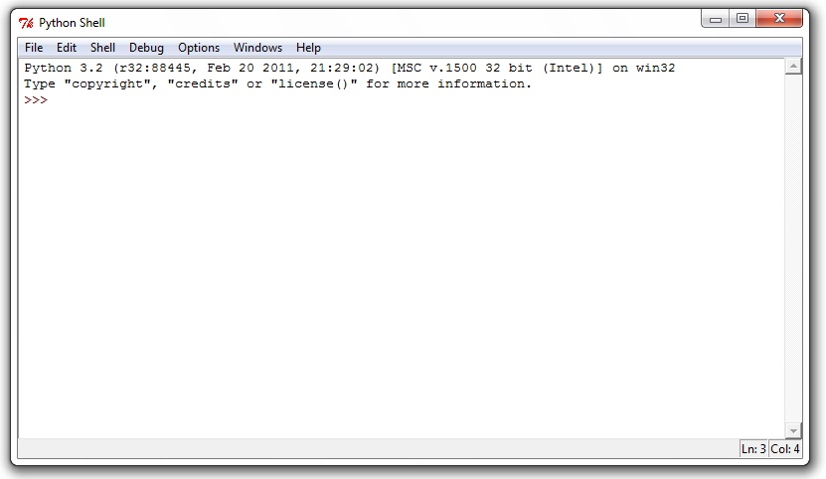
Writing in the Shell
The shell is that funky text area where you can type things in your IDE(or if you’re using a terminal, the weird prompt that comes up when you type “python”). It looks like this:

Slide 22
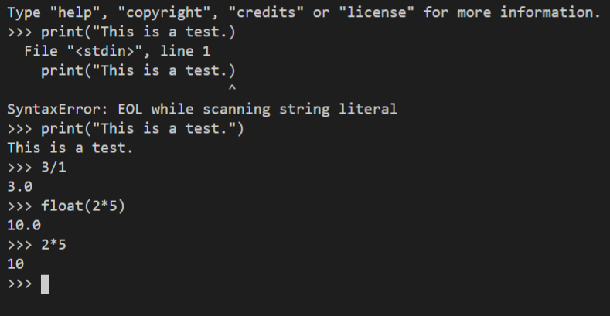
Writing in the Shell

Slide 23
Reminders
Our emails:
cassandra.laffan@ryerson.ca
adelacru@ryerson.ca
GitHub Repo (updated weekly):
https://github.com/cassLaffan/CPS1092020
Notes:
abakogeorge@ryerson.ca for Monday sections

